Slide 1





Mental Health Demand & Supply Analysis Across U.S. States
Presented by:
Group 4
Erica Zhao, Qibin Huang,
Sandhya Karki,Jianjun Gao

Slide 2


Background & Motivation
Why We Analyzed Mental Health Demand & Supply?
The U.S. faces a growing mental health crisis, worsened by the COVID-19 pandemic.
Service access remains unequal across states and regions.
Traditional data sources (e.g., hospital records, surveys) are often delayed or coarse.
There is an urgent need for timely, high-resolution mental health indicators.
Public search behavior may reflect real-time emotional needs.
But can we trust it?
A growing national concern but unevenly addressed.

Slide 3
Why Does it Matter?
1 in 5 U.S. adults experience mental illness each year
Mental health demand continues to outpace provider supply
Many regions are “service deserts” lacking licensed professionals
Policy planning needs faster, more localized indicators
Search trend data offers scalable, real-time potential for early signals

Slide 4



Research Question
Can digital search trends help identify mental health service gaps across U.S. states?

Slide 5
Project
Objectives:
Quantify mental health-related search demand at the state level
Normalize and map provider supply using HRSA data
Build models to detect spatial and temporal patterns in unmet need
Visualize demand–supply gaps to support public health planning

Slide 6

Data Sources
Overview
Google Trends Search Data
HRSA Workforce Data
Constructed Target Variable
400+ mental health keywords (2020–2024)
Collected monthly via Pytrends API
Covers symptoms, emotions, therapy, insurance topics
Licensed mental health providers per state
Metric: FTE (Full-Time Equivalent) per 100,000 population
Source: Area Health Resource Files (AHRF)
“Combined_Value”: Aggregated score from anxiety & depression-related search terms
Normalized and aligned by state and month

Slide 7
Google Trends:
Keywords & Collection
1
Keyword Strategy:
2
Collection via Pytrends API:
Curated 400+ mental health-related search terms
Max 5 keywords per API call
→ batched in groups of 3
Monthly resolution: reshaped from daily
Implemented exponential backoff & retry logic
Final dataset:
keyword-level normalized trends (state + month)
Covered categories:
Diagnostic terms (e.g., “clinical depression symptoms”)
Emotions (e.g., “crying for no reason”)
Therapy types (e.g., “CBT”, “group therapy”)
Insurance & affordability (e.g., “cheap counseling”)
Demographic focus (e.g., “depression in teenagers”)Smaller size
→ easier, cheaper, and faster to build

Slide 8

Google Trends:
Keywords & Collection
Diagnostic
Emotional Terms
“clinical depression symptoms”
“anxiety diagnosis”
“crying for no reason”
“always tired”
Therapy & Access
Insurance & Coverage
Demographics
“CBT”, “group therapy”, “cheap counseling”
“insurance for therapy”, “does insurance cover depression”
“depression in teens”, “anxiety in men”

Slide 9
Data Merging
& Feature Engineering
Merging Logic
Feature Engineering
Merged Google Trends and HRSA data by state and month
Unified date format to Month_Year
Removed missing values and non-informative columns
Extracted temporal features:
Year, Month, Quarter
One-hot encoded categorical variables: State, Indicated (Depression/Anxiety)
Constructed final target: Combined_Value
Normalized and aligned for modeling
Google Trends + HRSA → Merged Dataset → Feature columns → Combined_Value

Slide 10


Mental Health Search Trends
(2020–2024)
Pandemic Spike
Seasonal Patterns
Regional Differences
Search volume surged during early COVID years, peaking around mid-2021
Southern states showed higher average demand
Midwest generally lower and more stable
West showed more variance over time
Anxiety-related terms spiked in Q4 (Oct–Dec)
Depression-related terms rose during winter months

Slide 11
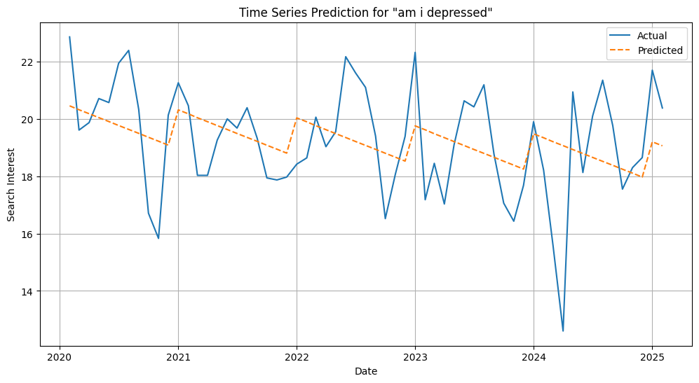
Linear Regression Modeling
Linear Regression: Baseline Model to Understand Patterns
Built Ordinary Least Squares (OLS) models as baseline
Separate submodels for Anxiety vs Depression
Additional submodels by U.S. region (Northeast, Midwest, South, West)
Categorical variables one-hot encoded
Time-based features (Year, Month, Quarter) included
Findings:
Anxiety models: better seasonal/geographic signals
Depression models: lower fit, higher noise
Southern states showed strongest positive coefficients

Slide 12
XGBoost Modeling
XGBoost: Capturing Non-Linear Demand Patterns
Setup:
Same target: Combined_Value (log-transformed in some models)
Features: Keyword trends + temporal fields (Year, Month)
Train-test split: 80/20, based on chronological order
Excluded: Categorical variables (State, Indicated) to reduce sparsity
Results:
Tuned model:
RMSE ≈ 9.41
Test R² ≈ 0.5865
Depression model:
RMSE ≈ 10.5
Captured baseline trends but missed abrupt spikes
Anxiety-related searches yield more consistent predictive patterns than depression.

Slide 13
Interpreting XGBoost:
SHAP Summary
What is SHAP?
SHAP = SHapley Additive exPlanations
Assigns contribution scores to each feature for each prediction
Helps us understand which keywords most influence model outputs
Approach:
Used shap.Explainer on trained XGBoost models
Generated global summary plots and feature impact rankings
Separate SHAP analysis for anxiety and depression models
Why It Matters:
Improves model transparency
Highlights which search terms carry meaningful demand signals
Supports public health interpretation of digital behavior

Slide 14
Top Influential Keywords
(SHAP)
Most Influential Search Terms:
Depression model:
“seasonal depression”
“chronic depression”
“depression weight loss”
“depression in women”
“depression fatigue”
Anxiety model:
“always tired”
“anxiety symptoms”
“am I anxious”
“panic attack”
“social anxiety”
Interpretation:
Clinical/structured keywords had higher SHAP values
Gender-specific terms (e.g., “in women”) often more predictive
Vague expressions like “feeling sad” had weak predictive power

Slide 15
Deployment
& Tech Stack
App Prototype: Built using Dash
Features:
Keyword trend explorer (monthly line plots)
Demand prediction interface
SHAP explanation viewer
Locally deployable via Dash run
Tools & Libraries:
Python (3.9), Jupyter Notebook
pandas, numpy, scikit-learn
xgboost, shap
matplotlib, seaborn, plotly for visualizations
Code & Dataset Access:
GitHub repository: github.com/sandhya-mgs2/Capstone-4A/

Slide 16

Conclusion
What We Learned？
Google search trends can serve as a timely proxy for population-level mental health demand
Anxiety-related terms were more predictable and seasonally structured
States with high search intensity often aligned with underserved regions
Clinical and structured keywords (e.g., “seasonal depression”) carried stronger predictive power
SHAP analysis validated model logic and revealed the most impactful search terms

Slide 17
Limitations
& Future Work
Limitations
No direct ground truth (search ≠ diagnosis)
Digital behavior varies by region, access, literacy
Difficult to capture sudden public health events (e.g., COVID spikes)
Current model limited to state-level granularity
Next Steps:
Integrate external signals (e.g., news, social media)
Incorporate demographic & socioeconomic variables
Expand to county- or city-level forecasting
Build real-time dashboard for public health agencies
Validate predictions with clinical data (e.g., CDC, HRSA reports)

Slide 18

DEMO
Visualization
Prediction
Prediction
Predictive Analytics Using Best Tuned XGBoost model
US Geographical Analysis of Depression-Related Search Trends 2024 by states
2. Animated Visualization of Depression & Anxiety Trends Across the US (2020-2024)

Slide 19
Thank You!

